Slide 1
DLIP 2022-1
Exercise Posture Assistance System
한동대학교 기계제어공학부
21700421 ChangMin An
21700433 JiWoo Yang

Slide 2
Introduction
Algorithm
Demo
Result
Development
Appendix
Contents

Slide 3

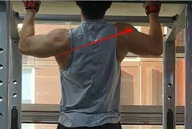
Introduction
Problem & Solution

Slide 4
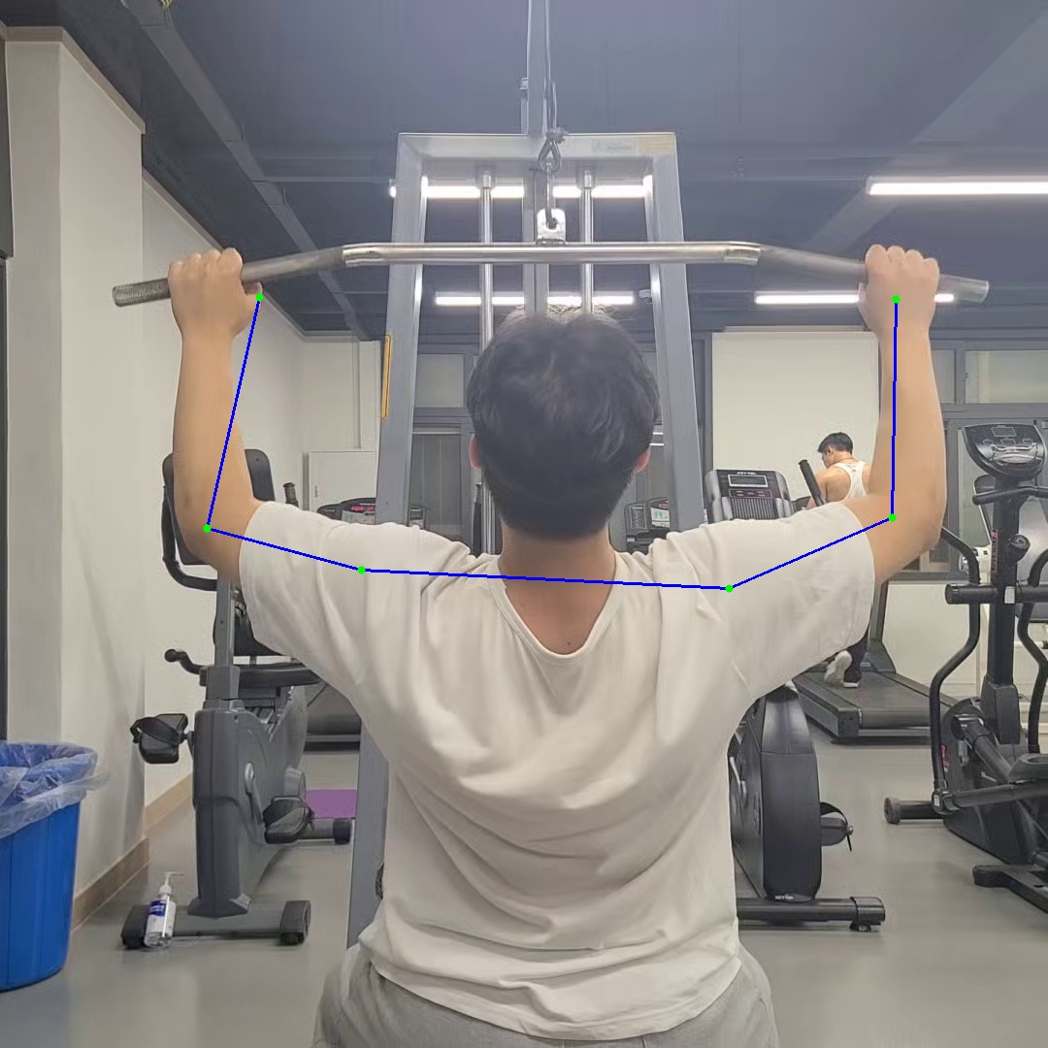
Introduction
MoveNet
Model
Using MobileNet V2, designed to be run real-time
Using COCO Keypoint Dataset 2017,
Joint
Provide x, y pixel values for 17 keypoints
Single pose estimation

Slide 5
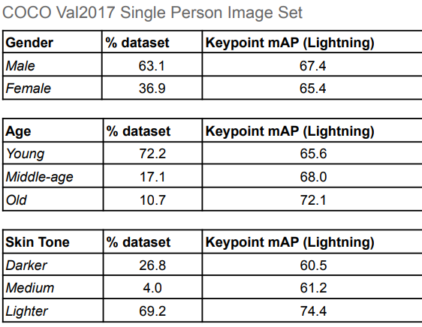
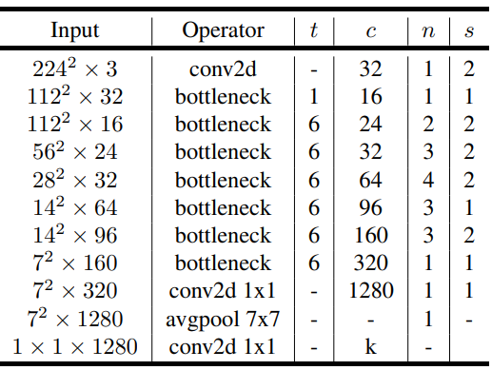
Introduction
MobileNet V2

Slide 6
Introduction
Features
Start
Enter user’s exercise count
Balancing postures
Exercising
Balance analysis in real time
Counting good exercise
Counting bad exercise
Reset
Initializing when hand down
Reset user’s count
Finish
Save best and worst postures
Print correct, incorrect exercise number

Slide 7
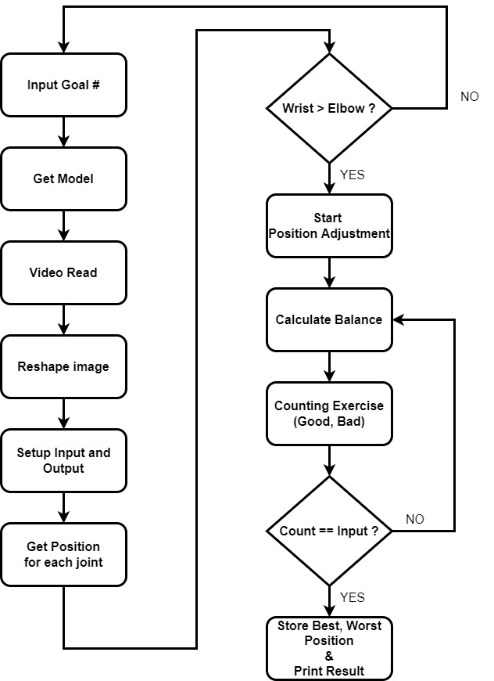
Algorithm
Flowchart

Slide 8
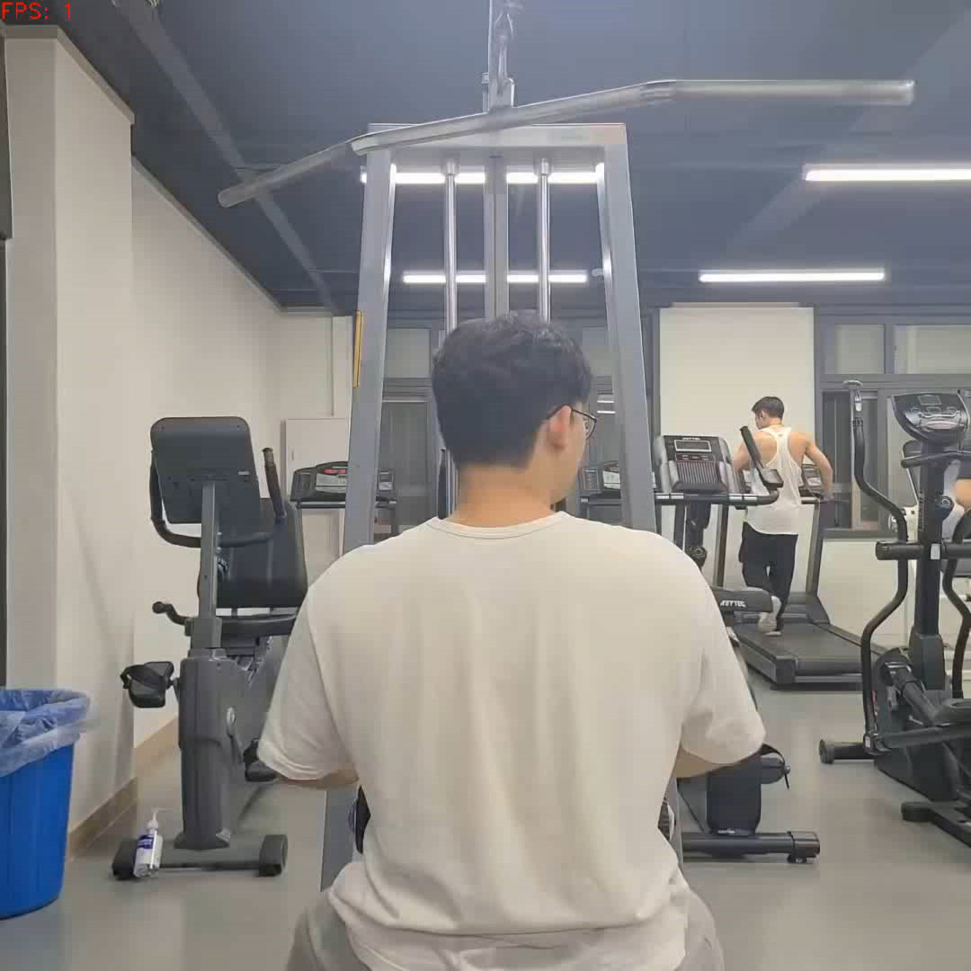
Demo

Slide 9
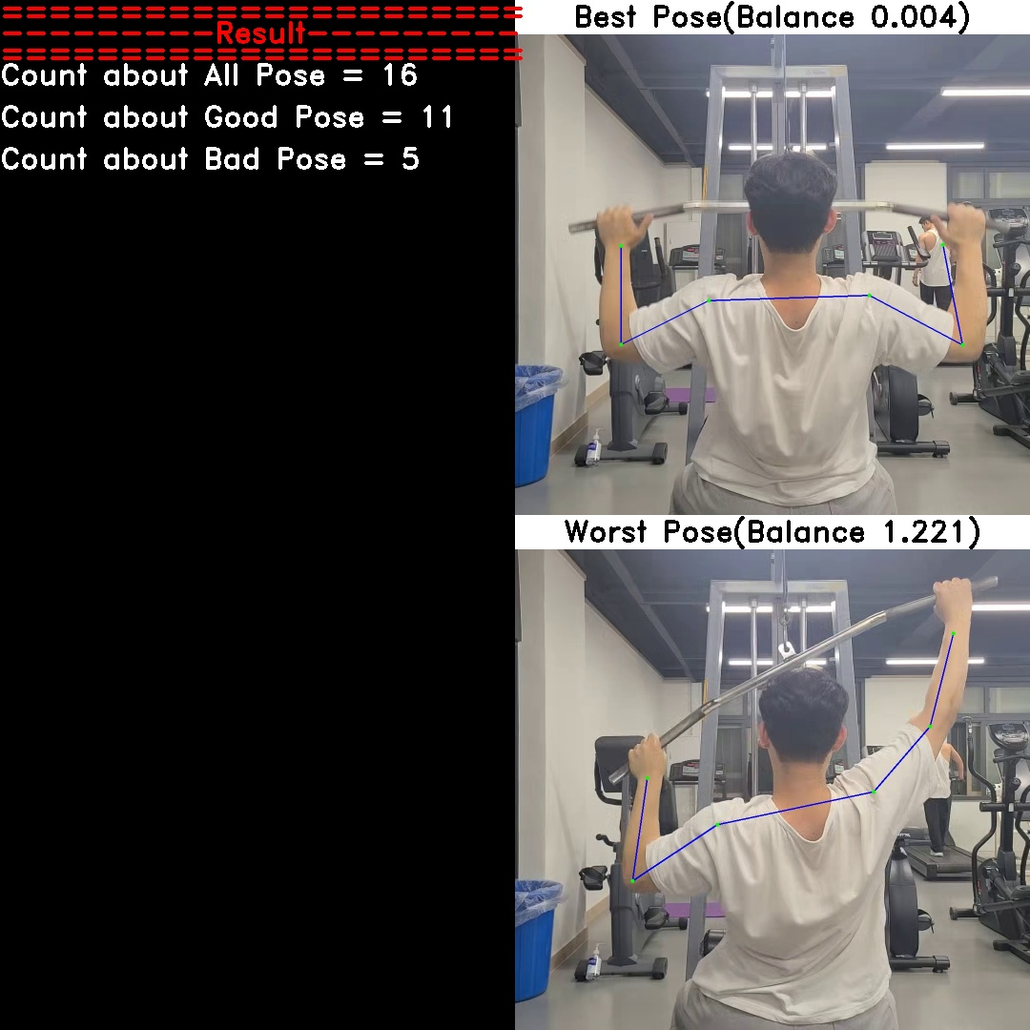
Result

Slide 10
Development
Single Pose Estimation
=> Multiple Pose Estimation
Processing for wrong estimation
Versatility about various weight training

Slide 11
Appendix
MoveNet Model
https://storage.googleapis.com/movenet/MoveNet.SinglePose%20Model%20Card.pdf

